Slide 1
PH108
Lecture 16: Diectrics - 2
Pradeep Sarin
Department of Physics
Supplementary reading: Griffiths Chapter 4
Especially Section 4.2.2 – physical meaning of bound charges Tutorial 6 - dielectrics

Slide 2

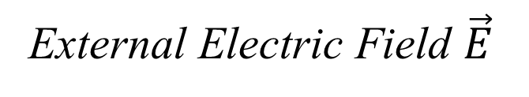
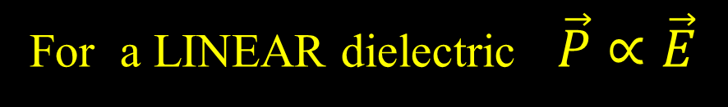



Polarization : Dielectric
$$σ_{b}$$
$$σ_{b}$$
External Electric Field $\vec{E}$
$$Polarization \vec{P}≡\frac{Dipole moment}{volume}$$
It is logical to expect that strong E causes higher P
For a LINEAR dielectric $\vec{P}∝\vec{E}$

Slide 3

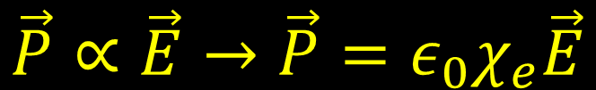
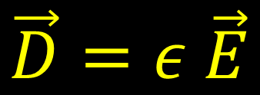
Permittivity of a linear dielectric denotes how much polarization it ‘permits’
$$\vec{P}∝\vec{E}→\vec{P}=ε_{0}χ_{e}\vec{E}$$
Electric susceptibility a number
To match units
Displacement:
$$\vec{D}=ε_{0} \vec{E}+\vec{P} =ε_{0}(1+χ_{e})\vec{E}$$
$$\vec{D}=ε \vec{E}$$
Permittivity of free space
Permittivity of dielectric

Slide 4




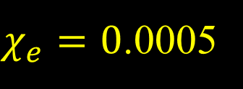

What are ‘common sense’ values of $χ_{e}$ ?
Vacuum : (‘there is nothing’)
$$χ_{e}=0 (by definition)$$
Air: ( O₂ + N₂ + CO_{x} etc )
$χ_{e}=0$.0005
Wood
$$χ_{e} \sim 1$$
$$χ_{e}=79$$
!
Water
$$\vec{D}=ε_{0}(1+χ_{e})\vec{E}$$
$$\vec{D}=ε \vec{E}$$
Permittivity of free space
Permittivity of dielectric

Slide 5

Some dielectrics are inherently polarized
This depends on the microscopic structure of the material
Each H₂O molecule
has built in dipole moment
Example: Water
H₂O
H⁺
H⁺
O⁻
H⁺
H⁺
O⁻
H⁺
H⁺
O⁻
H⁺
H⁺
H⁺
H⁺
O⁻
O⁻
H⁺
H⁺
H⁺
H⁺
External Electric Field $\vec{E}$
O⁻
O⁻
H⁺
H⁺
H⁺
O⁻
H⁺
O⁻
H⁺
H⁺
H⁺
O⁻
H⁺
O⁻
All dipoles turn to align easily

Slide 6
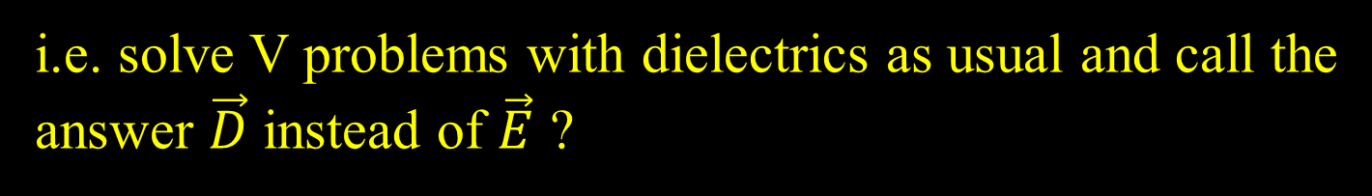
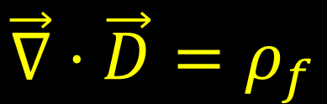


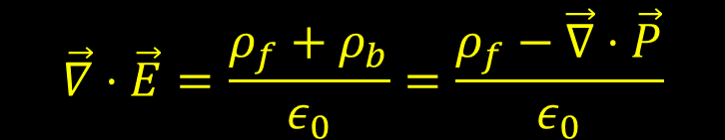
Gauss Law for dielectrics
$$\vec{∇}⋅\vec{D}=ρ_{f}$$
We got this by generalizing Gauss Law $\vec{∇}⋅\vec{E}=\frac{ρ}{ε_{0}}$
$$\vec{∇}⋅\vec{E}=\frac{ρ_{f}+ρ_{b}}{ε_{0}}=\frac{ρ_{f}−\vec{∇}⋅\vec{P}}{ε_{0}}$$
$$\vec{∇}⋅\left(ε_{0} \vec{E}+\vec{P}\right)=ρ_{f}$$
So is $\vec{D}$ just like $\vec{E}$ with different units?
i.e. solve V problems with dielectrics as usual and call the answer $\vec{D}$ instead of $\vec{E}$ ?
NO!

Slide 7
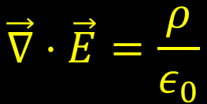
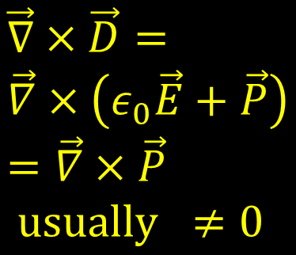


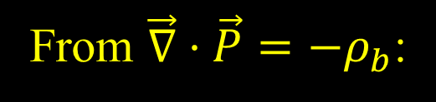

What is the difference between $\vec{D} \& \vec{E}$ ?
Divergence and Curl are needed to define a vector
From Gauss’s Law:
$$\vec{∇}⋅\vec{E}=\frac{ρ}{ε_{0}}$$
$$\vec{∇}×\vec{E}=0$$
From $\vec{∇}⋅\vec{P}=−ρ_{b}$:
$$\vec{∇}⋅\vec{D}=ρ_{f}$$
$$\vec{∇}×\vec{D}= \\ \vec{∇}×\left(ε_{0}\vec{E}+\vec{P}\right) \\ =\vec{∇}×\vec{P} \\ usually ≠0$$
except in special cases of symmetry

Slide 8

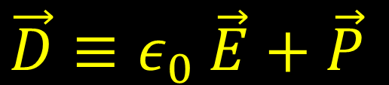
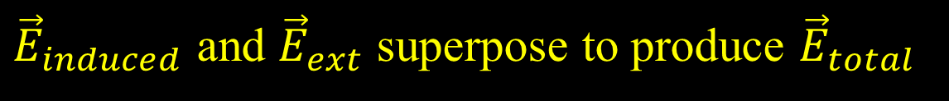

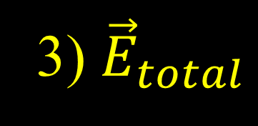
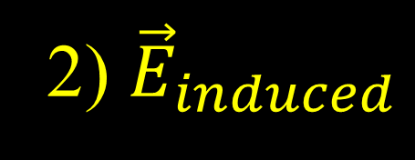

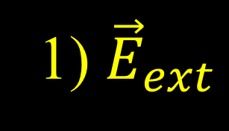
Question
$$\vec{D}≡ε_{0} \vec{E}+\vec{P}$$
There is an external field ${\vec{E}}_{ext}$
A dielectric placed in ${\vec{E}}_{ext}$ gets polarized, producing dipoles
These dipoles produce their own field ${\vec{E}}_{induced}$
${\vec{E}}_{induced}$ and ${\vec{E}}_{ext}$ superpose to produce ${\vec{E}}_{total}$
The $\vec{E}$ in the definition above is:
1) ${\vec{E}}_{ext}$
2) ${\vec{E}}_{induced}$
3) ${\vec{E}}_{total}$
Notes:
Correct (3) : E_total is the only thing you can measure
P is from the bound charge. E is from free charge + bound charge

Slide 9
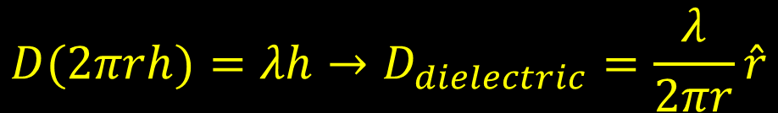

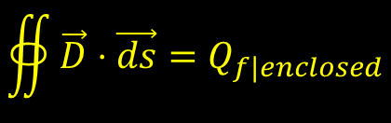

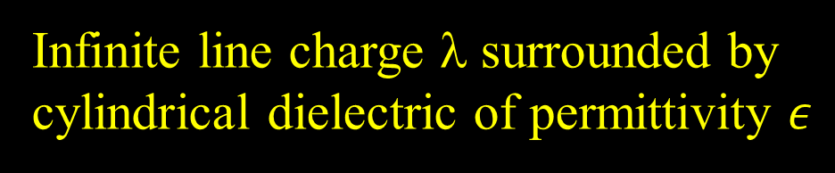
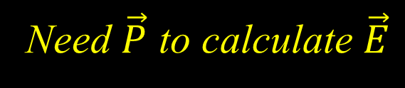

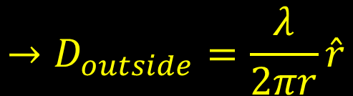
Example of using $\vec{∇}⋅\vec{D}=ρ_{f}$
λ
Infinite line charge λ surrounded by cylindrical dielectric of permittivity $ε$
Find $\vec{D}$, $\vec{E}$ everywhere
$$ε$$
Gaussian surface inside dielectric
$$∯{\vec{D}⋅\vec{ds}=Q_{f|enclosed}}$$
$$D(2πrh)=λh→D_{dielectric}=\frac{λ}{2πr}\hat{r}$$
Gaussian surface outside dielectric
$$→D_{outside}=\frac{λ}{2πr}\hat{r}$$
Need $\vec{P}$ to calculate $\vec{E}$
Notes:
Can’t find E=1/e(D-P) without knowing P
P outside not necessarily zero unless it is specified to be free space. If air, then P not zero in air.

Slide 10
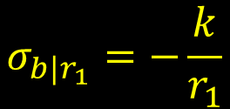
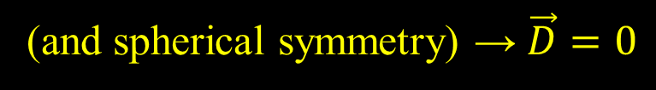


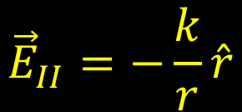

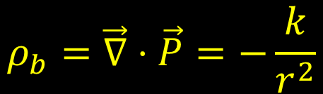
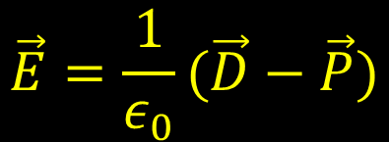
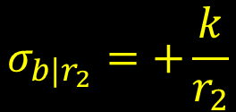
Spherical shell with $\vec{P}=\frac{k}{r}\hat{r}$
The polarization is given
III
II
r₁
I
Is there any free charge?
NO
r₂
(and spherical symmetry) → $\vec{D}=0$
$$\vec{E}=\frac{1}{ε_{0}}(\vec{D}−\vec{P})$$
$${\vec{E}}_{II}=−\frac{k}{r}\hat{r}$$
$${\vec{E}}_{I}={\vec{E}}_{III}=0$$
$$σ_{b|r_{1}}=−\frac{k}{r_{1}}$$
$$σ_{b|r_{2}}=+\frac{k}{r_{2}}$$
$$σ_{b}=\vec{P}⋅\hat{n}$$
$$ρ_{b}=\vec{∇}⋅\vec{P}=−\frac{k}{r^{2}}$$
Net polarized charge = 0 (Check!)

Slide 11


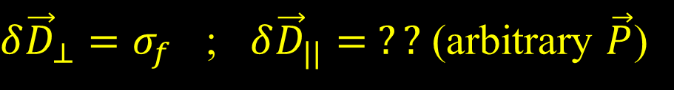

Boundary conditions in dielectrics
Recall: ${\vec{E}}_{||}$ is continuous, ${δ\vec{E}}_{⊥}=σ$
For a dielectric,
$$\vec{∇}⋅\vec{D}=ρ_{f}$$
$$ε$$
${δ\vec{D}}_{⊥}=σ_{f}$ ; ${δ\vec{D}}_{||}= ??$ (arbitrary $\vec{P}$)
Can still work out many cases using symmetry…

Slide 12
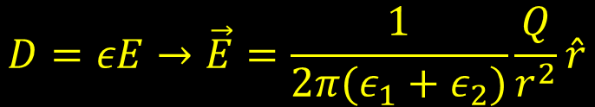

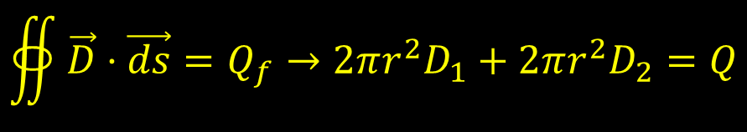
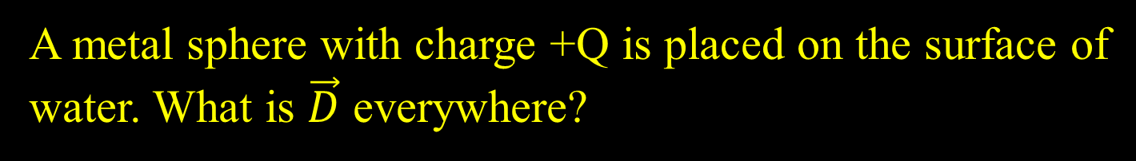

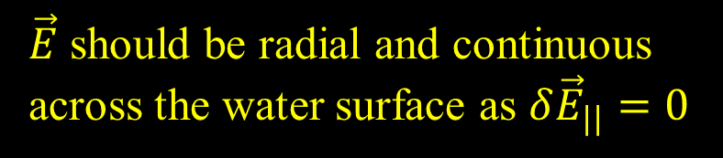
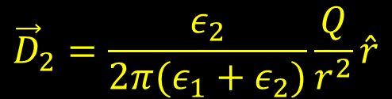

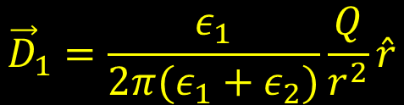
Example: boundary conditions in dielectric
A metal sphere with charge +Q is placed on the surface of water. What is $\vec{D}$ everywhere?
air
$\vec{E}$ should be radial and continuous across the water surface as ${δ\vec{E}}_{||}=0$
$$ε_{2}$$
So $\vec{D}$ will be different in water and air
$$ε_{1}$$
$$∯{\vec{D}⋅\vec{ds}=Q_{f}→2πr^{2}D_{1}+2πr^{2}D_{2}=Q}$$
water
$${\vec{D}}_{1}=\frac{ε_{1}}{2π(ε_{1}+ε_{2})}\frac{Q}{r^{2}}\hat{r}$$
$$D=εE→\vec{E}=\frac{1}{2π(ε_{1}+ε_{2})}\frac{Q}{r^{2}}\hat{r}$$
$${\vec{D}}_{2}=\frac{ε_{2}}{2π(ε_{1}+ε_{2})}\frac{Q}{r^{2}}\hat{r}$$

Slide 13
More problems on dielectrics in Tutorial 6 – dielectrics
(Note):
Two Tutorial #6 files on Moodle
first on Multipoles & conductors
second on Multipoles & Dielectrics

